Slide 1


Slide 3
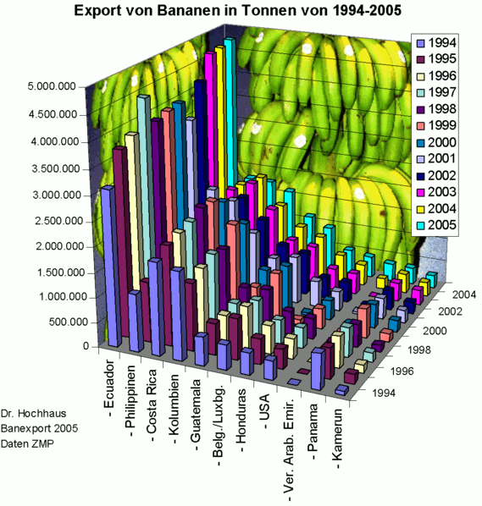
Did the USA or Honduras export more bananas in 1997?
Did the UAE, export more of fewer bananas between 1996 and 1998?
Approximately how many bananas were exported by Columbia in 1999?
How does the Philippians compare to Columbia?

Slide 4
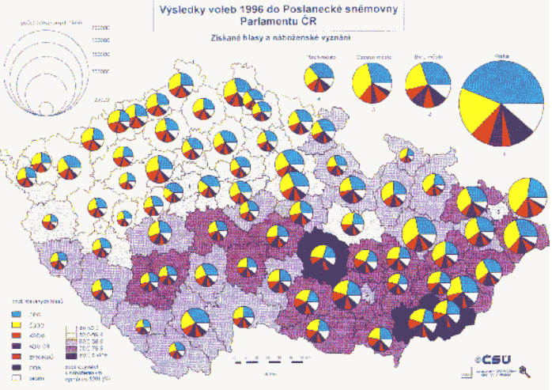

Slide 5
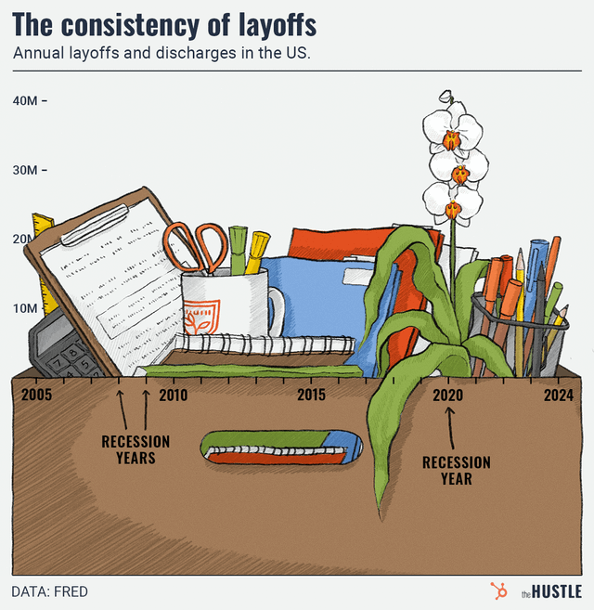

Slide 6
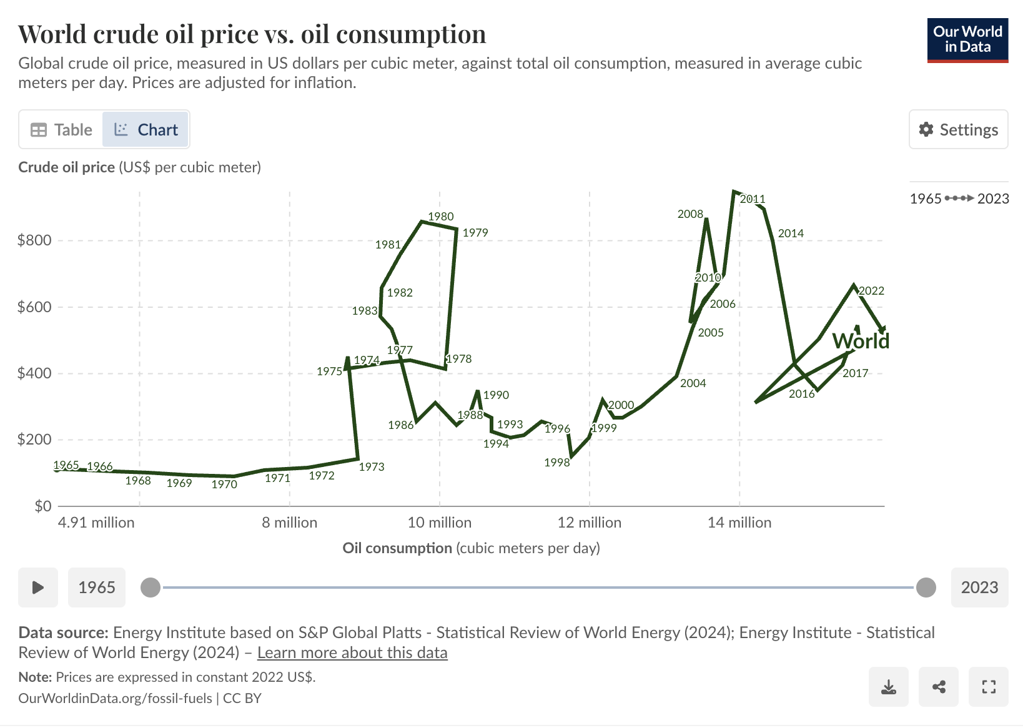

Slide 7
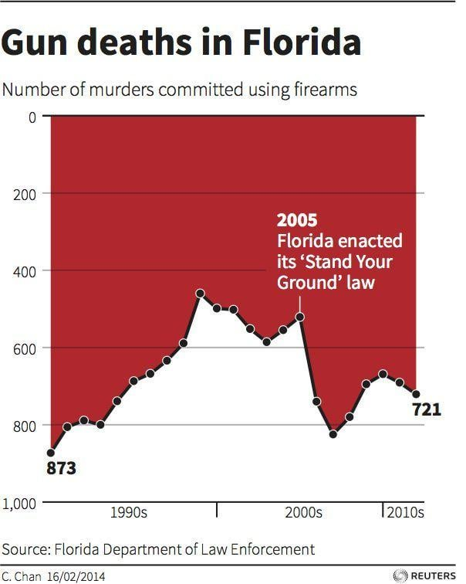

Slide 8

Reducing cognitive load

Slide 9
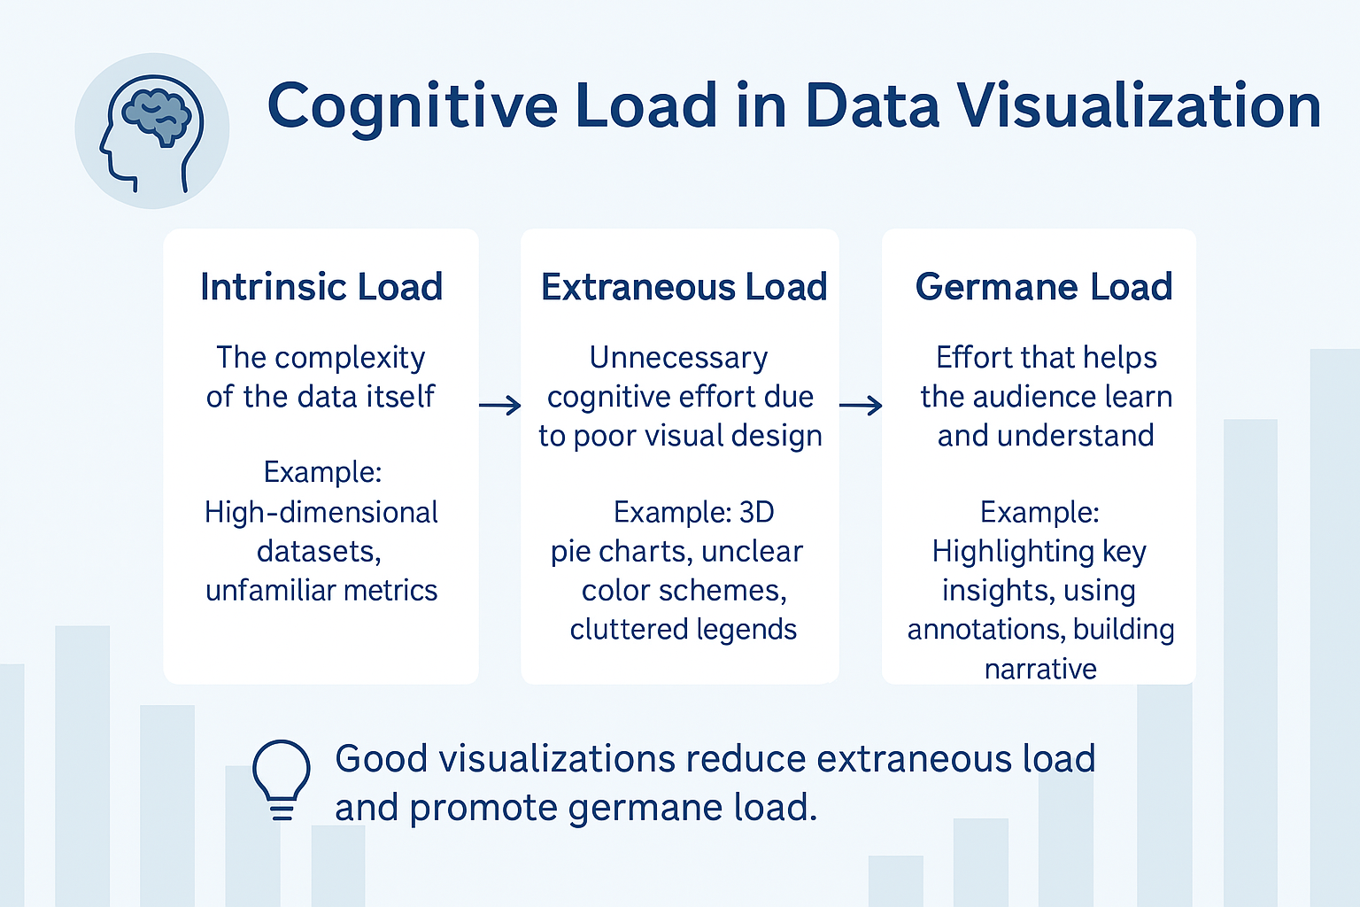

Slide 10
Cognitive Load

Slide 11
How to remove clutter

Slide 12
Be Deliberate

Slide 13
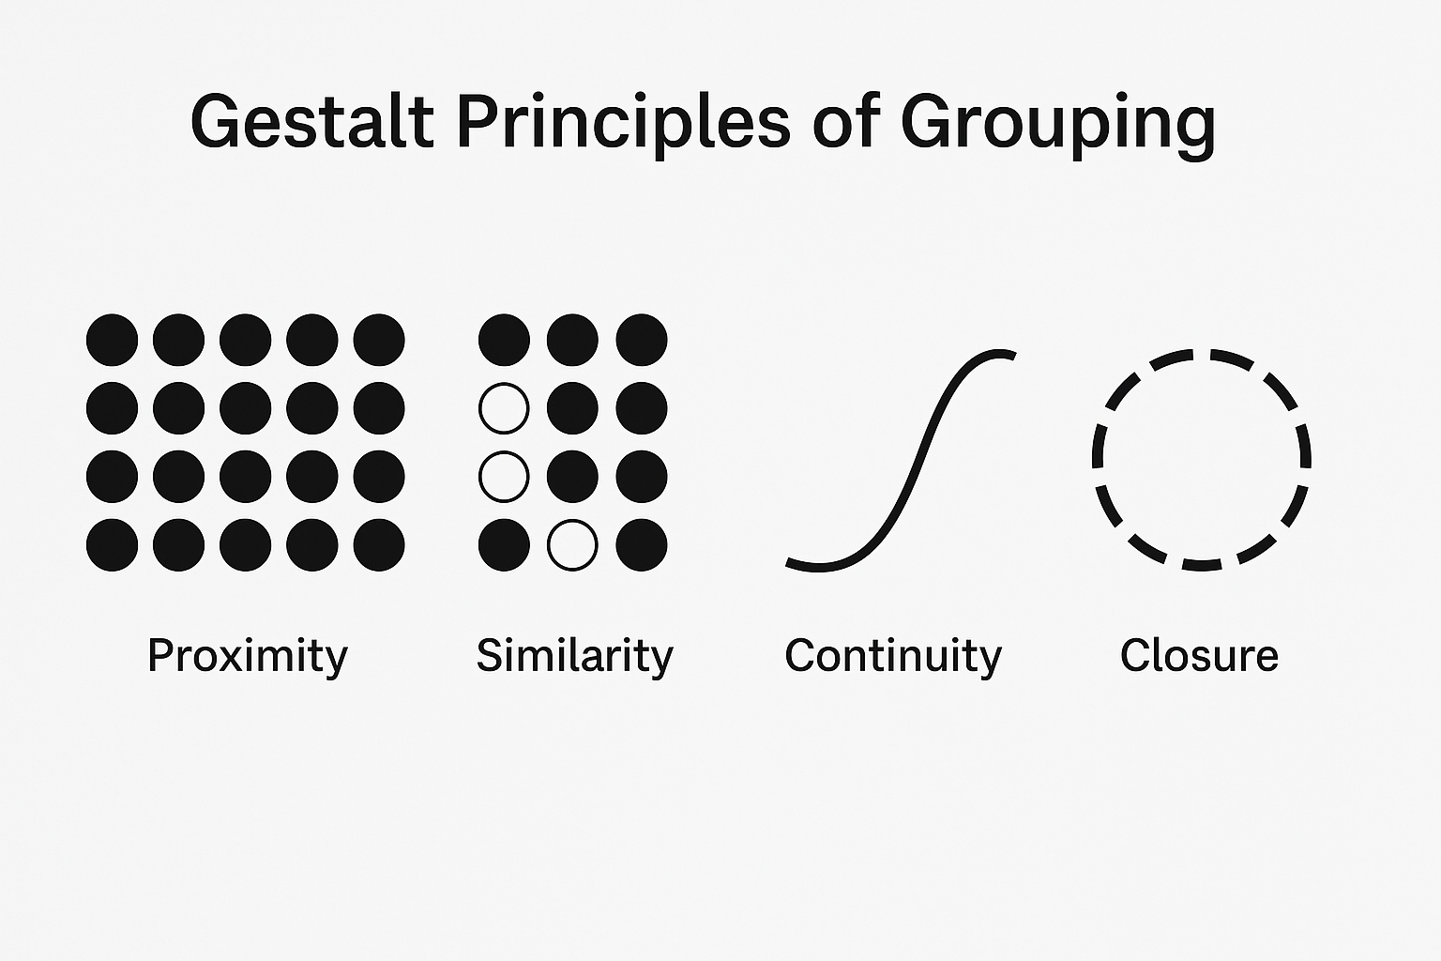

Slide 14
Data Storytelling

Slide 15
Match your visual to your message

Slide 16
Putting it All Together

Slide 17
Resources
Storytelling with

